Slide 1
2019 NYC Yellow Taxi Trip Duration Prediction
Final Project of Practical Data Science (15-688)
Anqi Wang (anqiw2)
Zehao Guan (zehaog)
https://github.com/zach96guan/15-688_PDS_Project
Notes:
Hello everyone, our project is 2019 New York City Yellow Taxi Trip Duration Prediction.
The goal of project is to predict the duration length of yellow taxi trip using some regression models.
The code implementations are included in the bottom GitHub link.

Slide 2
Motivation
Idea from experience with analysis and visualization on Pittsburgh Port Authority’s time series data in hw2
Inspired by Kaggle competition about prediction duration and total fare of NYC taxi given published dataset
Notes:
Motivated by the homework 2, analysis and visualization on time series data of buses in Pittsburgh;
Also we get insights from a Kaggle competition, predict duration and total fare given pre-curated NYC taxi data.

Slide 3

Workflow
Model 1
Model 2
Model Selection
Web Scrape
Feature Engineering
…
Cleaning
Data
Results
Model N
Notes:
Then let me briefly introduce the workflow of our project.
We use web scraping to extract the raw data from NYC Open Data API.
Then, through data cleaning, initial analysis and feature engineering, we put up with a series of models.
Finally, by model evaluation and selection, we figure out the model with the best metrics performance, and get the corresponding results as output.

Slide 4
Data Extraction
Trip Time | 1/1/19 ~ 4/1/19
Pick Up Location ID | <= 50
Web Scraping Time | 90 mins
File Size | 192M
Number of Rows | 1,838,913
Number of Features | 18
Socrata API
Sample Data
VendorID | tpep_pickup_datetime | tpep_dropoff_datetime | passenger_count | trip_distance | RatecodeID | store_and_fwd_flag | PULocationID | DOLocationID | payment_type | fare_amount | extra | mta_tax | tip_amount | tolls_amount | improvement_surcharge | total_amount | congestion_surcharge
1 | 06/30/2019 11:58:32 PM | 07/01/2019 12:00:42 AM | 1 | 0.2 | 1 | N | 90 | 186 | 1 | 3.5 | 3 | 0.5 | 1.45 | 0 | 0.3 | 8.75 | 2.5
https://github.com/zach96guan/15-688_PDS_Project/blob/master/preprocess.ipynb
Notes:
For the data extraction part, by taking advantage of the Socrata API, we get the experimental data.
The description of dataset is listed in the following table, we take about 90 mins to scrape more than 180 thousand rows of trip record.
Bottom lists the sample row, with totally 18 different features for one taxi trip.

Slide 5
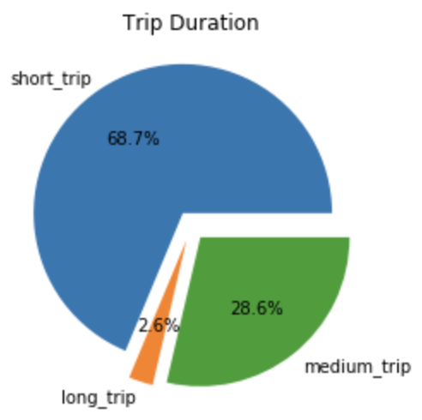
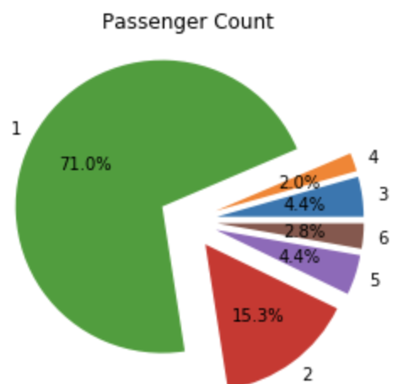
Data Analysis
https://github.com/zach96guan/15-688_PDS_Project/blob/master/data_analysis.ipynb
Notes:
Now, we try to have a fundamental analysis about the dataset after preliminary data cleaning.
By statistical methods and visualization with tools like sklearn and seaborn, we get the plots as follows.
These are the pie plots for the trip duration and passenger count.

Slide 6
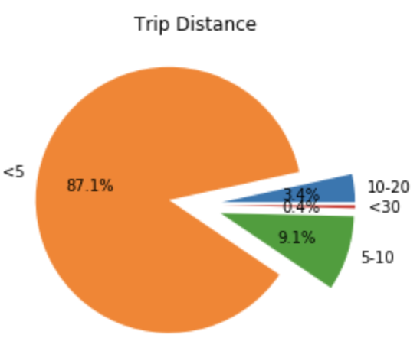
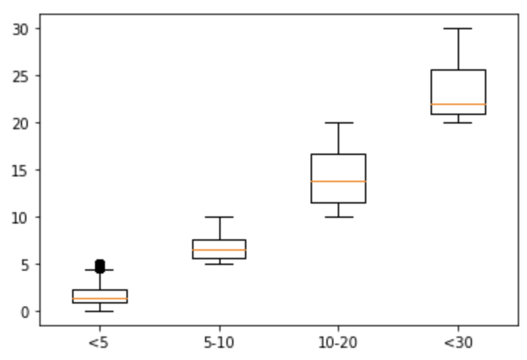
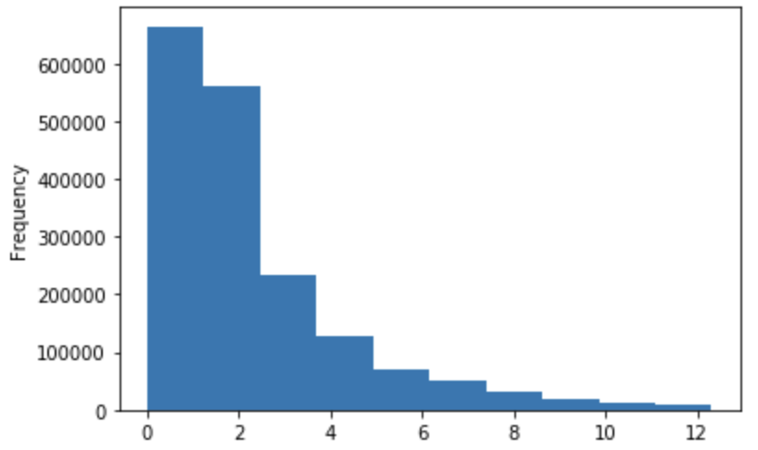
Data Analysis
https://github.com/zach96guan/15-688_PDS_Project/blob/master/data_analysis.ipynb
Notes:
And here we use pie plot, box plot, and histogram to get the distribution of distance of journey.

Slide 7
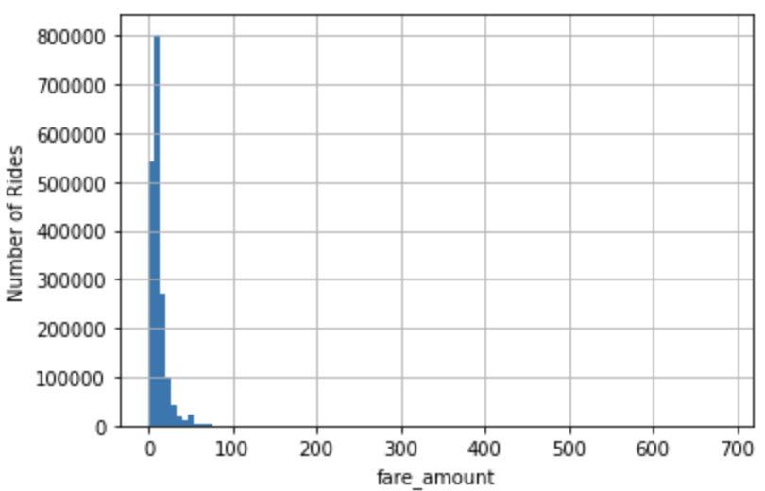
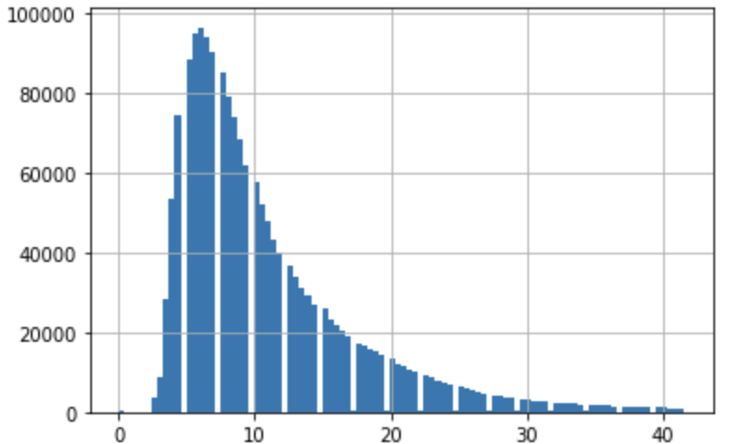
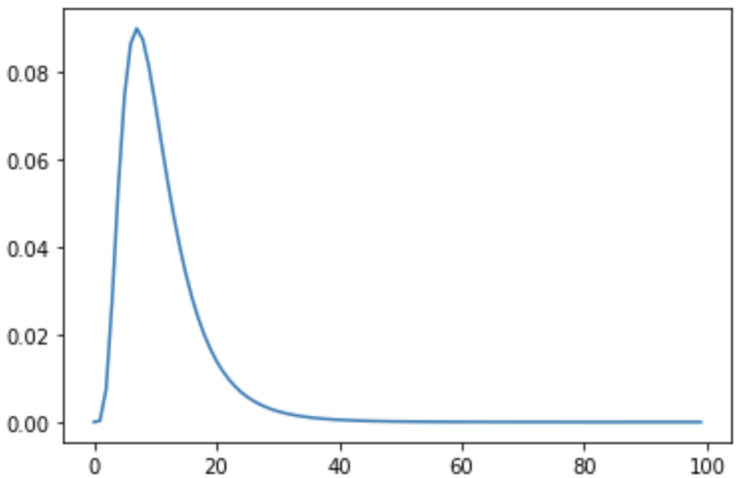
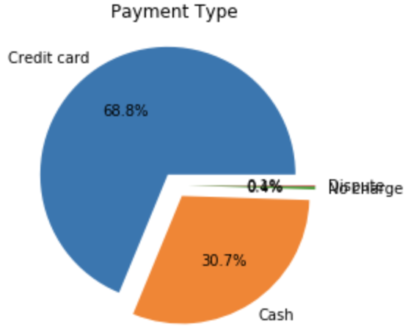
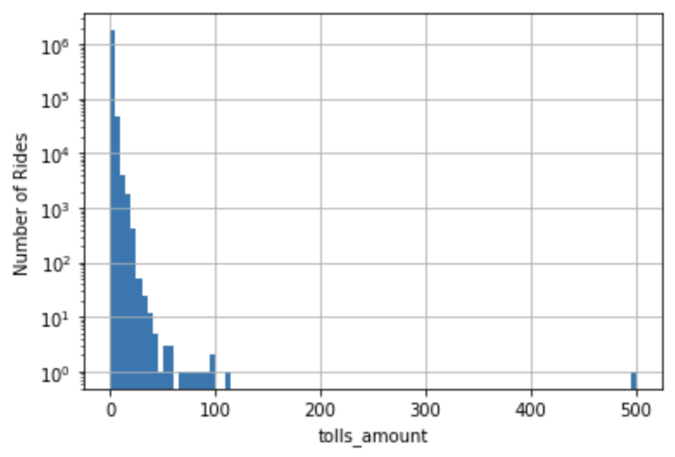
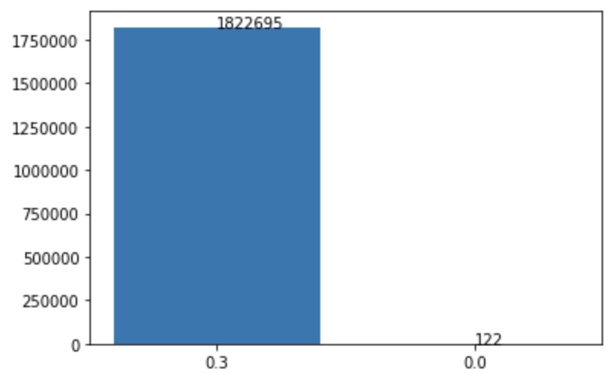
Data Analysis
https://github.com/zach96guan/15-688_PDS_Project/blob/master/data_analysis.ipynb
Notes:
Besides, we attempt to utilize methods such as log normalization and min-max scale to smooth the dataset, which is of great importance for regression model to converge steadily.

Slide 8
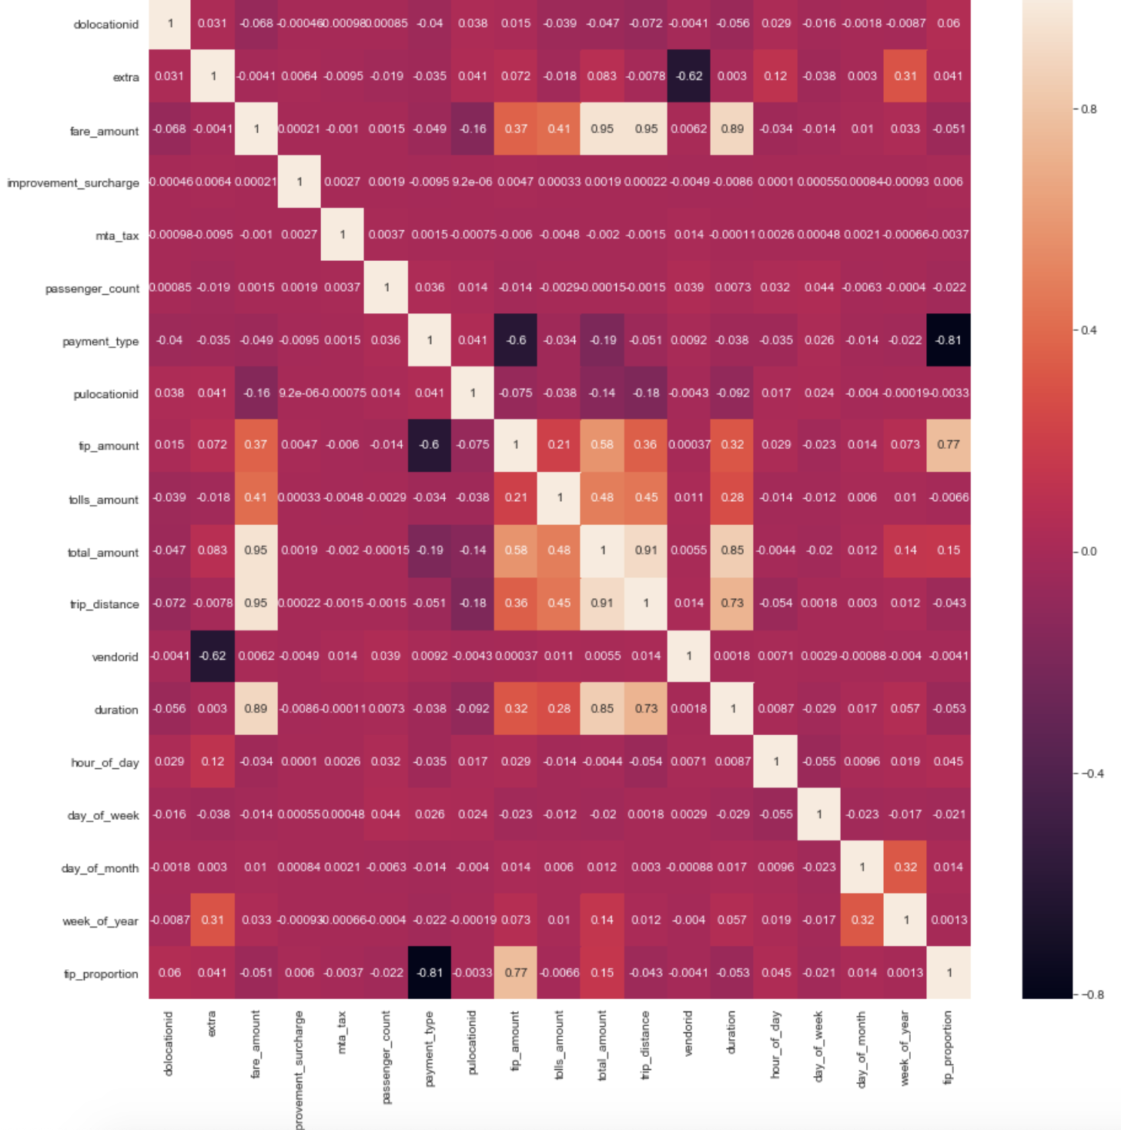
Feature Engineering
Drop Outliers
Add Time Related Features and Tip Proportion
Visualize Variance Inflation Factor
Visualize Correlation Heatmap
https://github.com/zach96guan/15-688_PDS_Project/blob/master/preprocess.ipynb
Notes:
Not restricted to the given features of domain knowledge, we wish to create new features by feature engineering.
Also, use variance inflation factor and correlation heatmap, we are able to select the most promising features for our models.

Slide 9
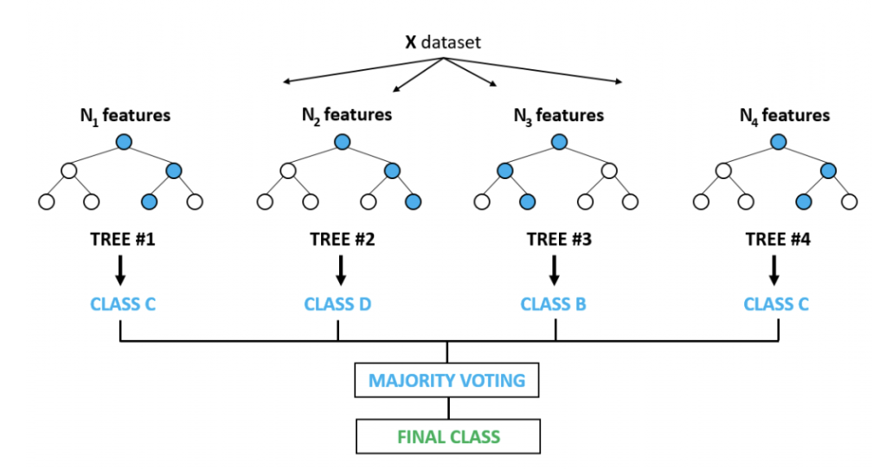

Models
Neural Network
Linear Regression
Tree-based Models
https://github.com/zach96guan/15-688_PDS_Project/blob/master/model.ipynb
Notes:
Now let’s jump to the model part. First, we split the cleaned data to train set and test set.
Next, we take the linear regression and its variances as baseline.
Then we think of applying tree-based models, such as random forest, XGBoost for regression.
We also try to design neural networks to learn the features by deep learning.

Slide 10
Evaluation
 | Linear Regression (Baseline) | Random Forest | Gradient Boost | XGBoost | Neural Networks
Train RMSE | 2.504 | 1.524 | 1.818 | 1.197 | 1.656
Test RMSE | 2.465 | 1.514 | 1.773 | 1.205 | 1.722
https://github.com/zach96guan/15-688_PDS_Project/blob/master/model.ipynb
Notes:
The evaluation results are listed in the table.
As you can see, after greedy search for best parameters, we select the best model, XGBoost which has the lowest root mean square error in comparison to other models.

Slide 11
Summary
Linear regression model and its variations are taken as our baseline model. On both train and test set, they get higher RMSE scores. Compared with Linear Regression model, Random Forest model has around 15% lower RMSE improvement.
XGBoost model achieves lowest RMSE score on train and test set. It is an optimized distributed Gradient Boosting method which leads to both greater metrics performance and less time cost.
During the whole project, we experience the full data science development cycle. For future work, we will go deeper with the algorithm in each model and try to apply them in different aspects.
Notes:
In summary, through the training of this team project, we experience the data science development cycle.
Starting from extracting the dataset from raw sources, step by step, we do data cleaning, initial analysis about the data distribution and features, furthermore data preprocessing and feature engineering.
After these, we will feed the clean data to our designed models, and by model evaluation and selection, we pick up the best candidate model for future prediction.

Slide 12
Reference
https://www.kaggle.com/c/nyc-taxi-trip-duration
https://data.cityofnewyork.us/Transportation/2019-Yellow-Taxi-Trip-Data/2upf-qytp
https://dev.socrata.com/
http://cs229.stanford.edu/proj2016/report/AntoniadesFadaviFobaAmonJuniorNewYorkCityCabPricing-report.pdf
https://scikit-learn.org/stable/modules/generated/sklearn.tree.export_graphviz.html
https://scikit-learn.org/stable/auto_examples/ensemble/plot_forest_importances.html
https://keras.io/getting-started/sequential-model-guide/
Notes:
Here are some reference links. Thanks for attention!

